Slide 1
SE Sector Led Improvement
SE DCS Peer Challenge 2018
Workshop Day 2 pm

Slide 2
Objectives
To consider the insights and amend and add to them
To turn the insights into ‘how to challenges’
To select some of these ‘how to’ statements and consider possible solutions/actions that could be taken to achieve them
To identify what is needed to make some of these actions happen

Slide 3
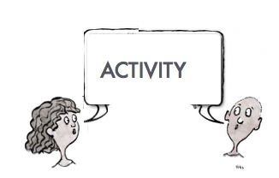
Reflection on insights
In groups round tables
Look through the insights on the sheet on your table
tick those that you agree with, circle those you disagree with
add any additional insights that you feel are missing
For each insight identify a goal or outcome you would like to achieve

Slide 4
Feedback from groups

Slide 5
Developing possible solutions/ actions
As a group choose one of the goals
write as many ideas as possible one idea per post-it
aim for quantity to reach quality
build off other people’s ideas
generate unusual ideas
accept all ideas at this stage without judgement
Share your ideas on the flipchart sheet in the centre of the table

Slide 6
Refine the ideas
Of the range of the ideas on the table, vote for the three actions/ solutions that you think will have the highest impact on your goal and are possible to implement

Slide 7
Feedback on proposed actions/solutions

Slide 8
Evaluation first thoughts on the peer challenge What went well? Even better if?

