Slide 1
SE DCS peer challenge
Author and further enquiries to annawright@me.com

Slide 2
Your name and role
Your prior experience of peer challenge
One question you’d like to answer this morning
What are the enablers to making this process work well, and what are the barriers?

Slide 3
Aims and Objectives
To understand the purpose of the new SE peer challenge, and the new process being used for the peer challenge days
To be aware of the factors that make peer challenge more rigorous and effective and those that diminish its impact
To understand the process and tools provided so that all teams are familiar with it and can use them to help each authority get insights and perspectives into its strengths and risks in a way that enables improvement
To consider what action needs to be taken before, during and after the days to get the most out of the process

Slide 4
Sector led improvement regional alliances
Serve as the primary means by which the sector will address the early identification of concerns before they reach crisis point;
Build and share best practice;
Contribute to an evidenced based model for improvement;
Create the conditions for a learning system which unites all stakeholders from regulation to delivery in a robust and collective approach to improvement.

Slide 5
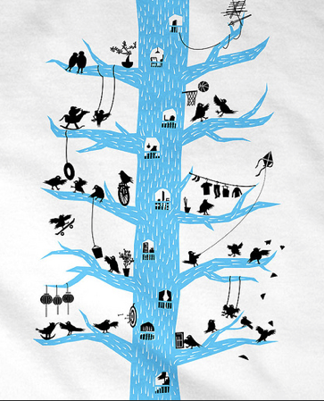
Building system resilience
To enable members of a community to connect and use community resources to thrive in a changing and precarious environment
a resilient community is ‘‘one that takes intentional action to enhance the personal and collective capacity of its institutions and citizens to respond to and influence the course of social and economic change.”
Canadian Centre for Community Renewal. (2000) The community resilience manual. A resource for rural recovery and renewal. Port Alberni, Canada: Centre for Community Enterprise at link

Slide 6
SE peer challenge
the process

Slide 7
The new peer challenge process
Each authority will produce a self-assessment, signed off by the DCS, during the autumn – dates agreed with each triad in advance
SESLIP optionally reviews the draft Ofsted self-assessment – looking at the data, strengths, whether there is a holistic picture and window on practice
Hold peer challenge days in January and February. The days will be 3 x 2-hour challenge sessions with breaks and a wrap-up session.
The days will be attended by the 3 x DCS and up to 3 members of their team they wish to bring
SESLIP is providing a facilitator who will also collect and write up examples of best practice/common systemic issues that need to be addressed.
The aims of the sessions are to produce insights, offers and asks
A summit meeting in the Spring to share and celebrate best practice, highlight the common issues that may require collective action discuss any next steps and approve the SESLIP improvement plan and support for the following year.

Slide 8
Optional review of self assessment by SESLIP team will explore:
To what extent has the SA highlighted strengths, with evidence of impact as well as activity
Is there any discrepancy between data and conclusions?
Can the LA show it is able to identify caseload issues
Does the SA tell a holistic story, or does it describe silo’d information?
Does it address key issues picked up in previous Ofsted reports?

Slide 9
Desired output from peer challenge days
Key strengths of each LA which can be offers to others in the SE and be written up as case studies for wider circulation
Insights on any systemic issues or signatures of risk as a result of feedback from colleagues
Key asks that might be made of others in the region to support each local authority’s improvement journey

Slide 10
Understanding the data

Slide 11
Peer challenge data tool
Aims:
A single sheet where as much data as possible is pulled in to one place and shows relative performance
A tool that allows LAs to compare their performance with the SE, England and a selected LA.
Based on the most up to date quarterly and annual data
(We’ll be using this when reviewing the self evaluations)

Slide 12
Making the process
work well

Slide 13
The purpose
Are the self-assessments taking into account all possible signatures of risk?
What excellent practice should be shared more widely? and
Where people are experiencing significant challenges, how can others help?

Slide 14
What are the enablers to making this process work well, and what are the barriers?

Slide 15
The values underpinning this process
Mutual respect, openness and honesty
Non-judgemental feedback
The need to diagnose and understand why things are like they are
A practical focus on how outcomes for young people could be improved

Slide 16
Power dynamics

Slide 17
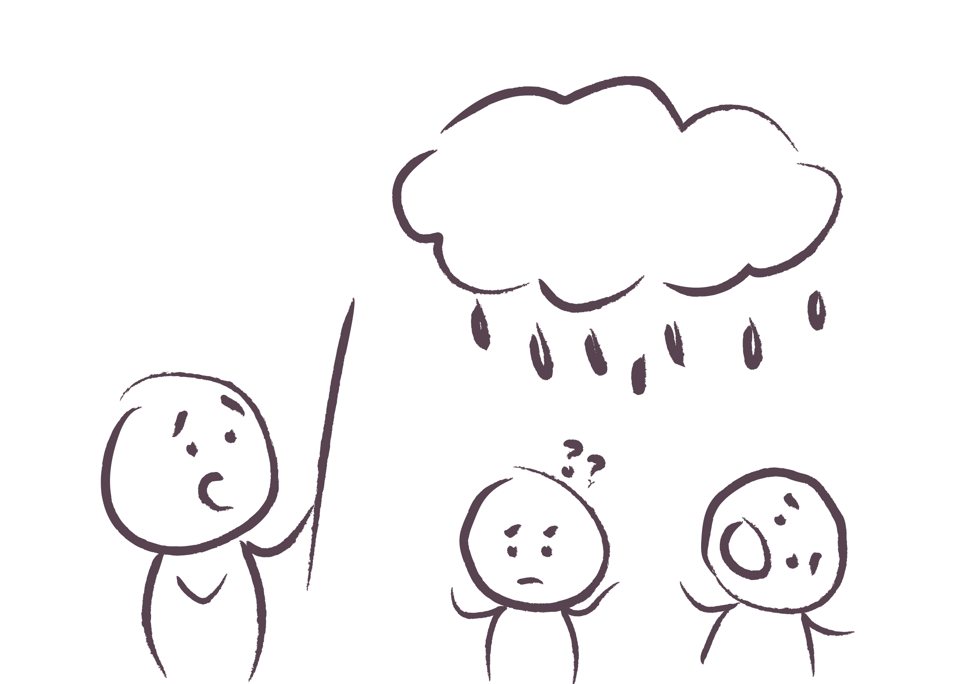
@Patrick Quattlebaum
Male
Woman
Other male

Slide 18
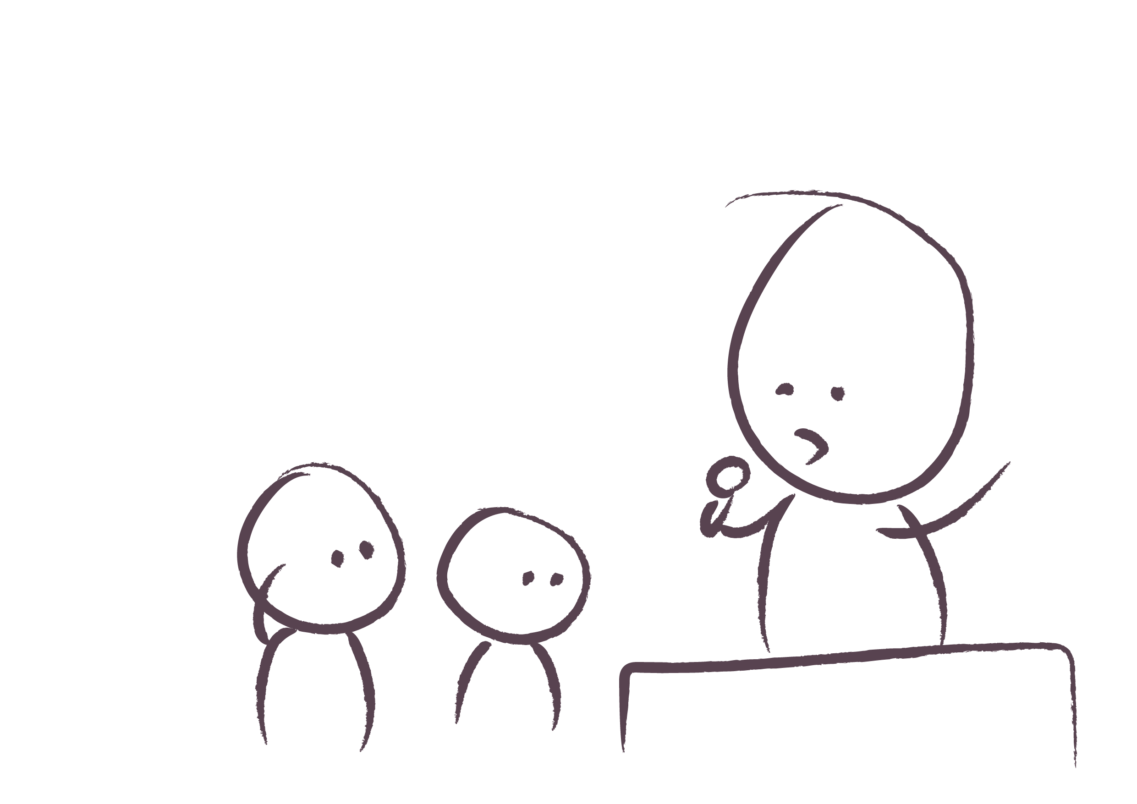
@Patrick Quattlebaum
BIG Local Authority
small Local Authorities

Slide 19
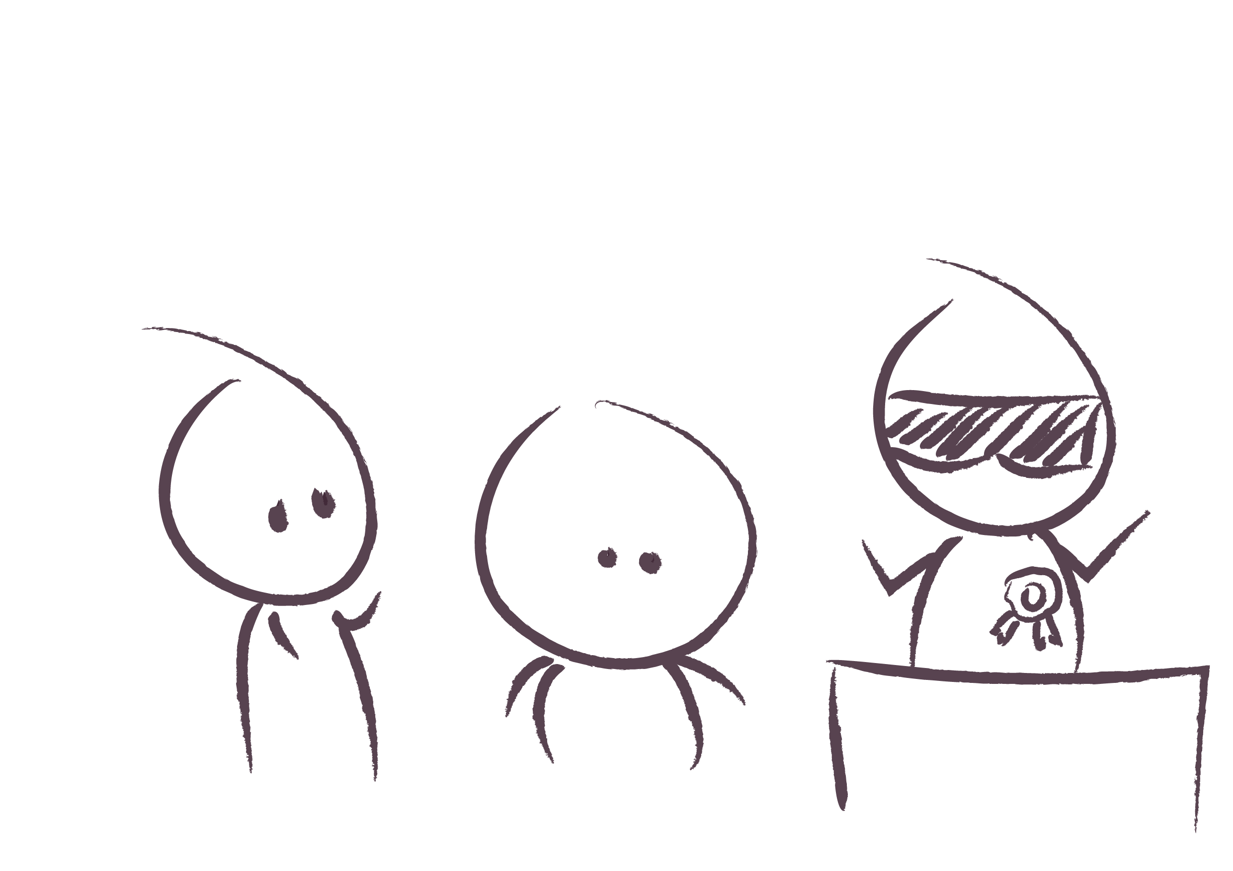
@Patrick Quattlebaum
Outstanding
Inadequate
Requires improvement

Slide 20
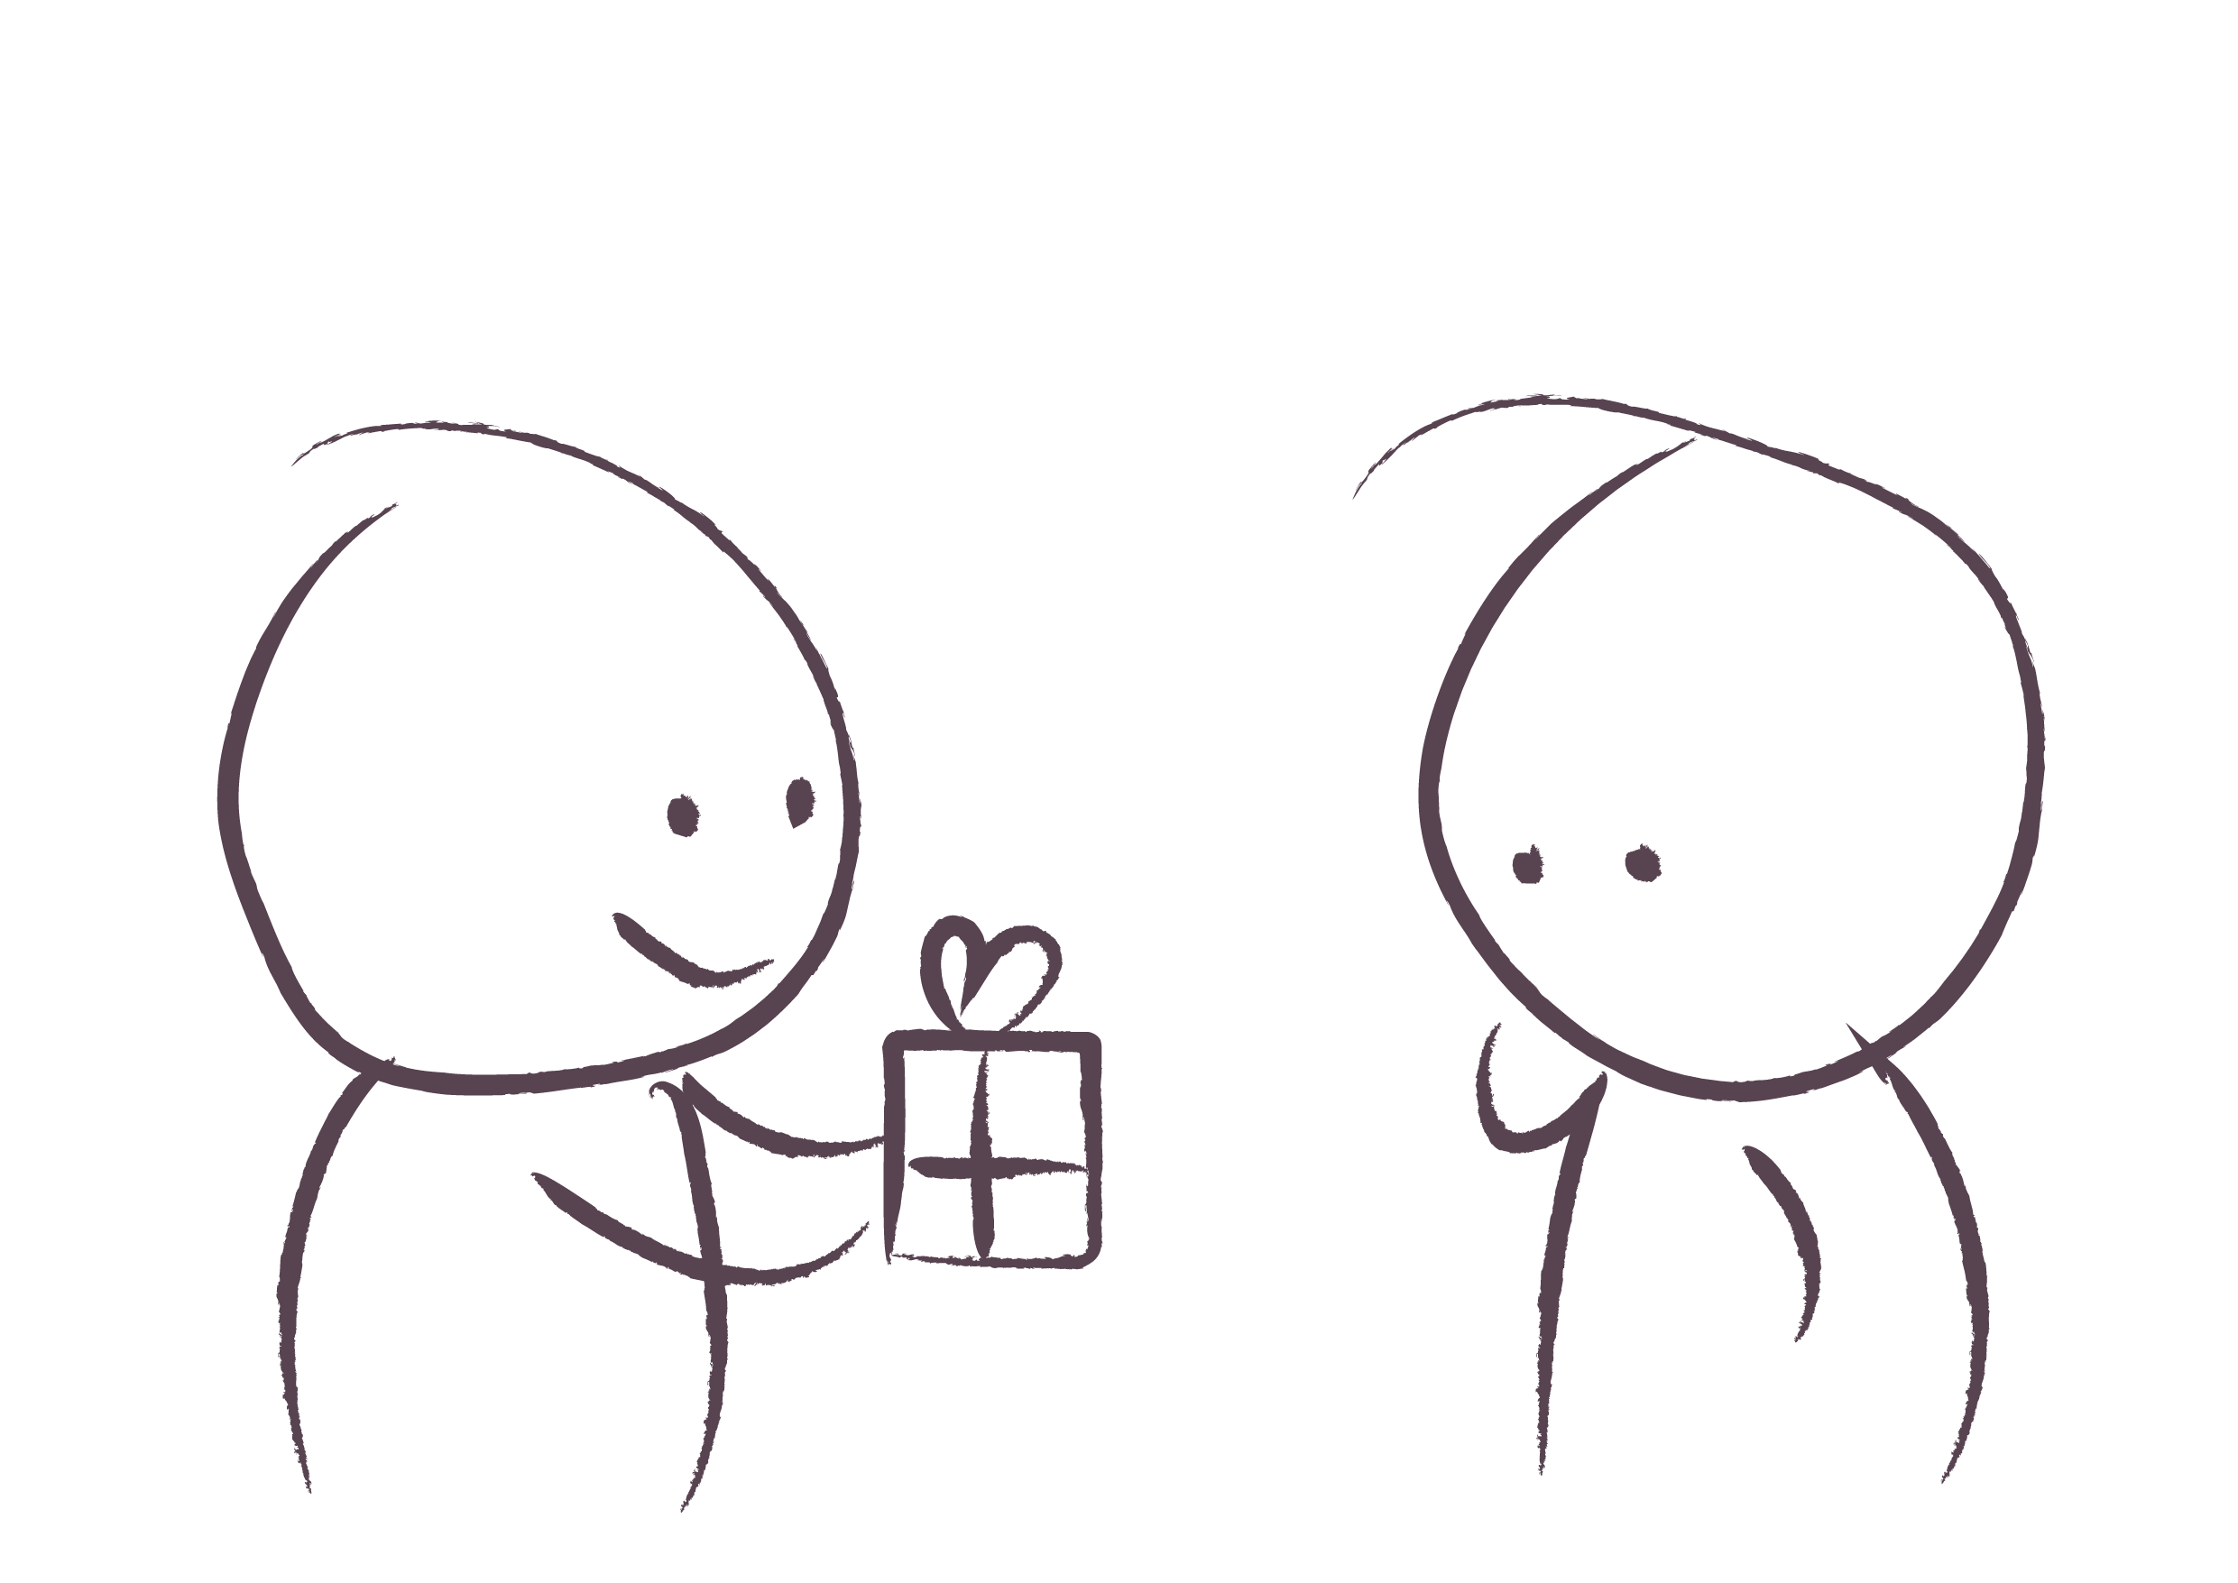
Sharing knowledge
@Patrick Quattlebaum

Slide 21
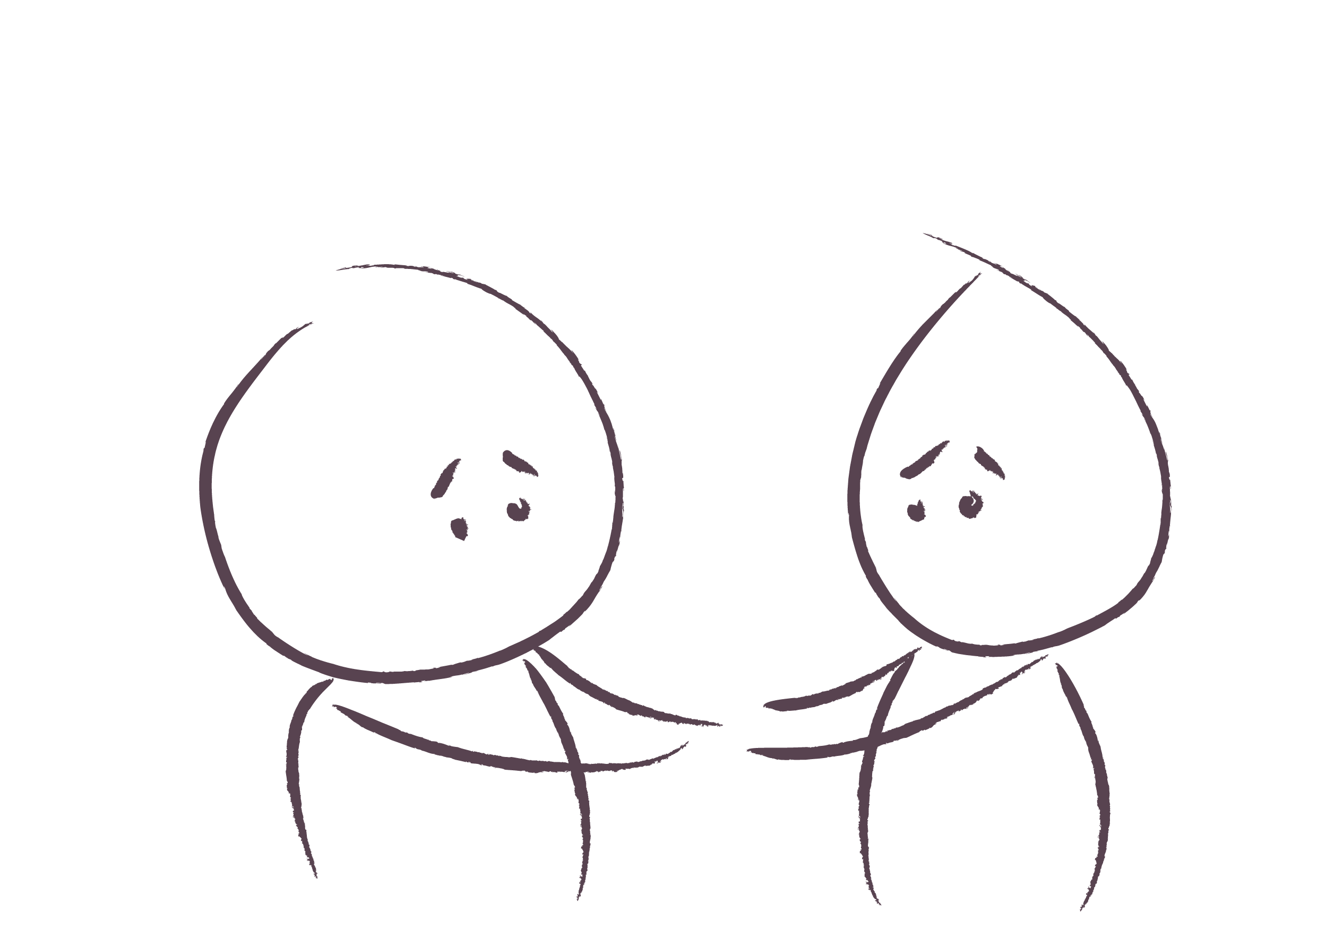
Supporting each other
@Patrick Quattlebaum

Slide 22
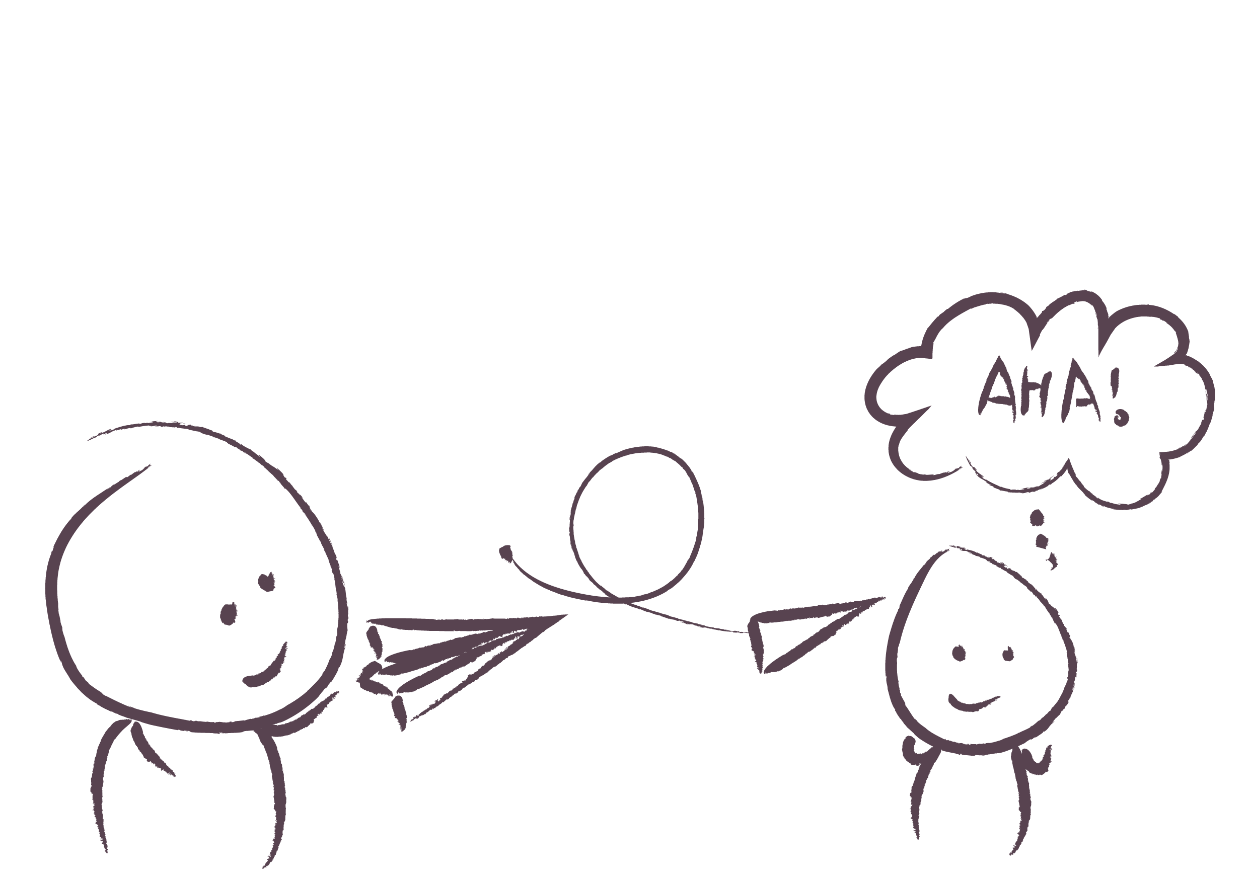
Giving an insightful message
@Patrick Quattlebaum

Slide 23
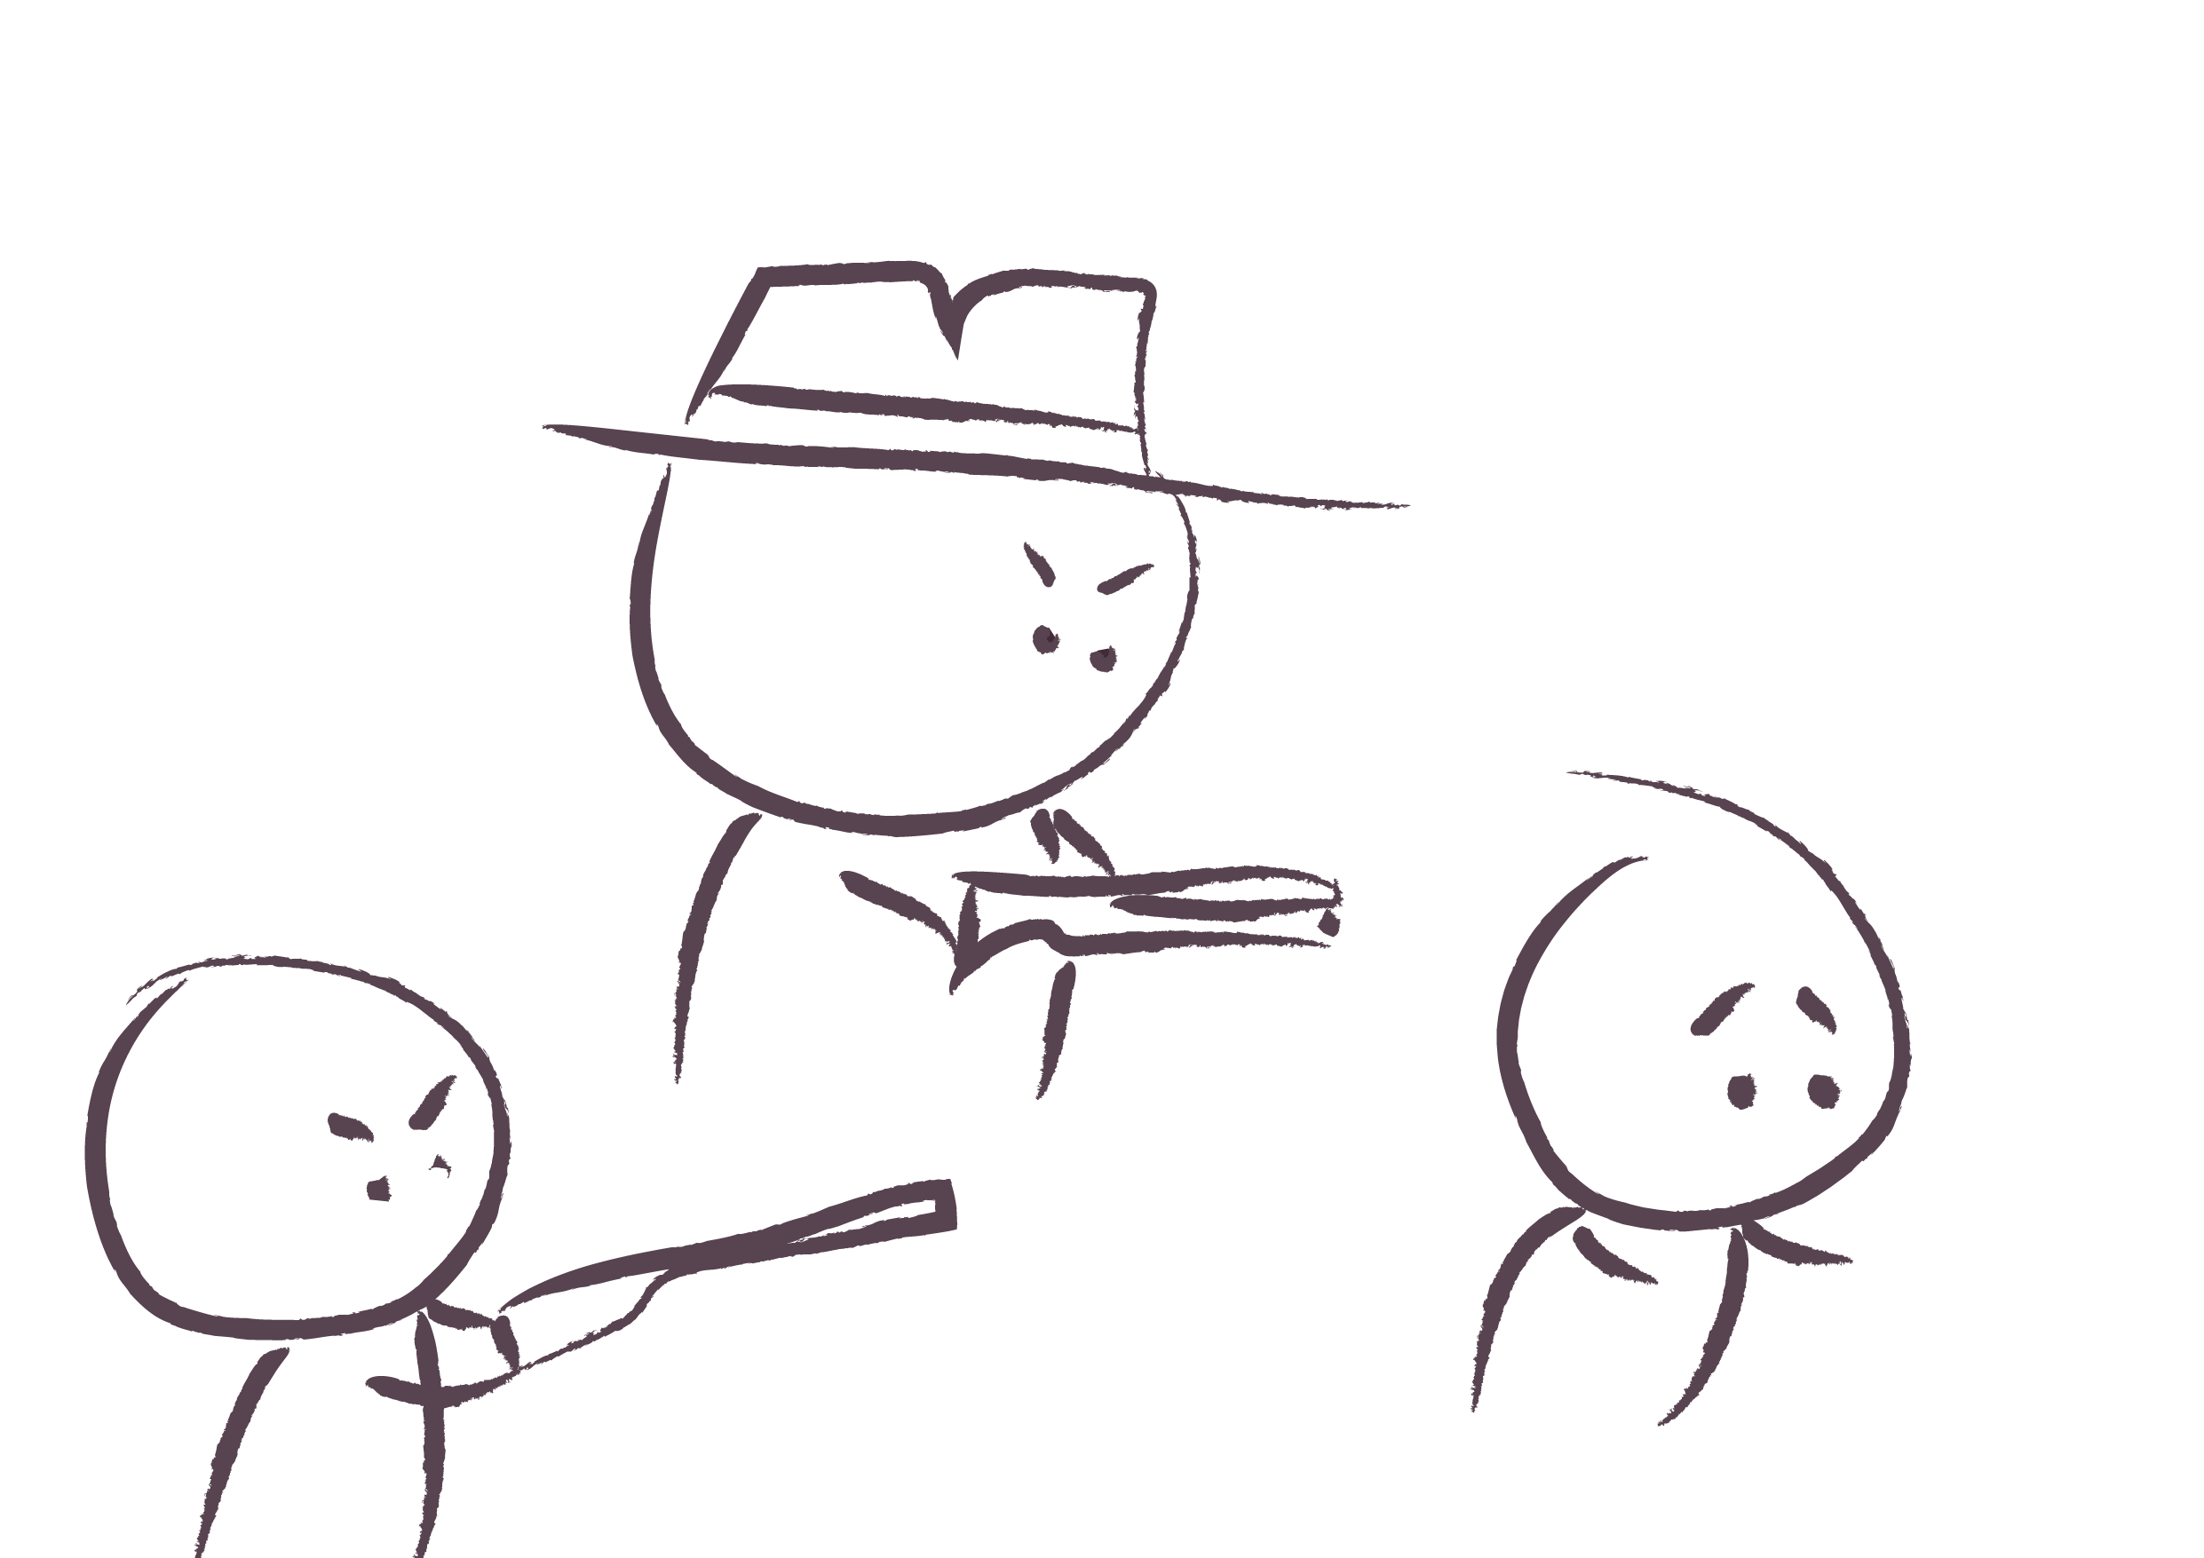
Attacking the presenter
@Patrick Quattlebaum

Slide 24
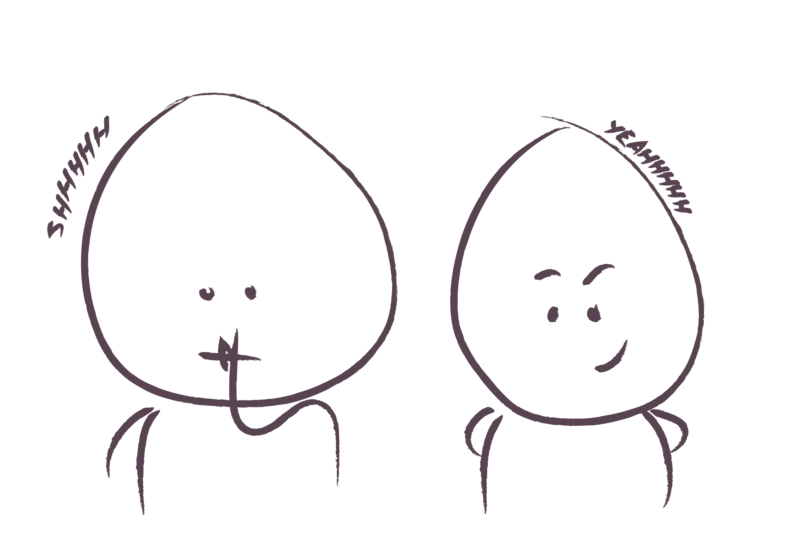
Staying quiet...
@Patrick Quattlebaum

Slide 25
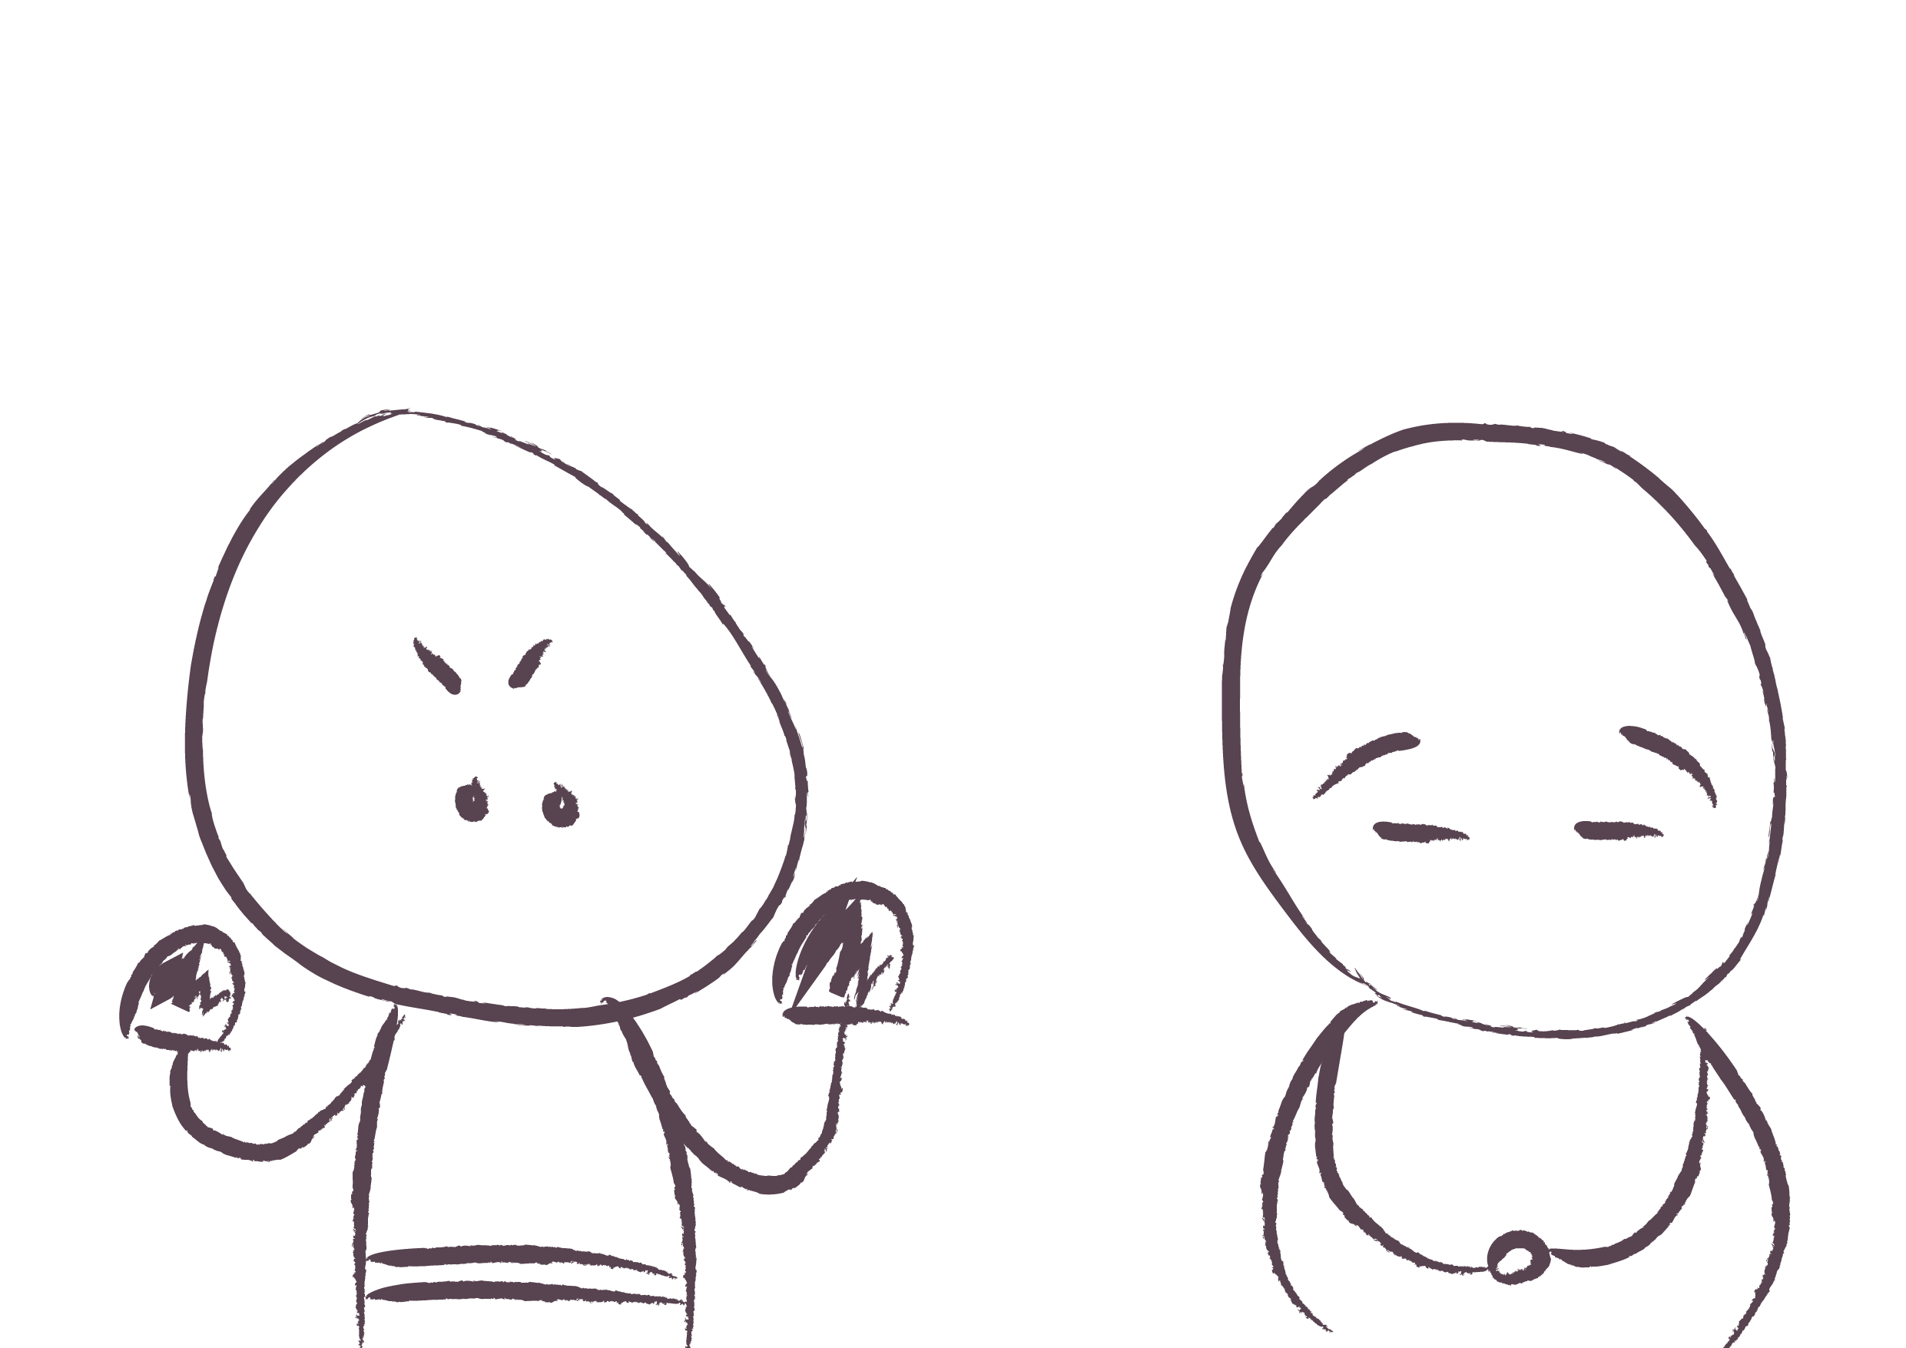
@Patrick Quattlebaum
Fighter
Pleaser

Slide 26
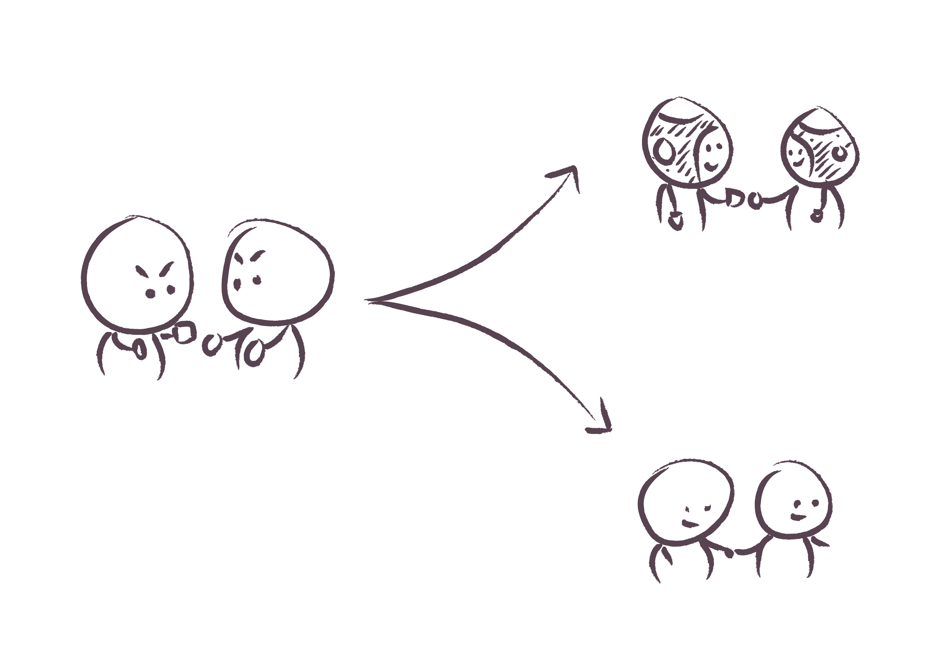
Challenging
Supporting
@Patrick Quattlebaum

Slide 27
A little bit of
neuroscience

Slide 28
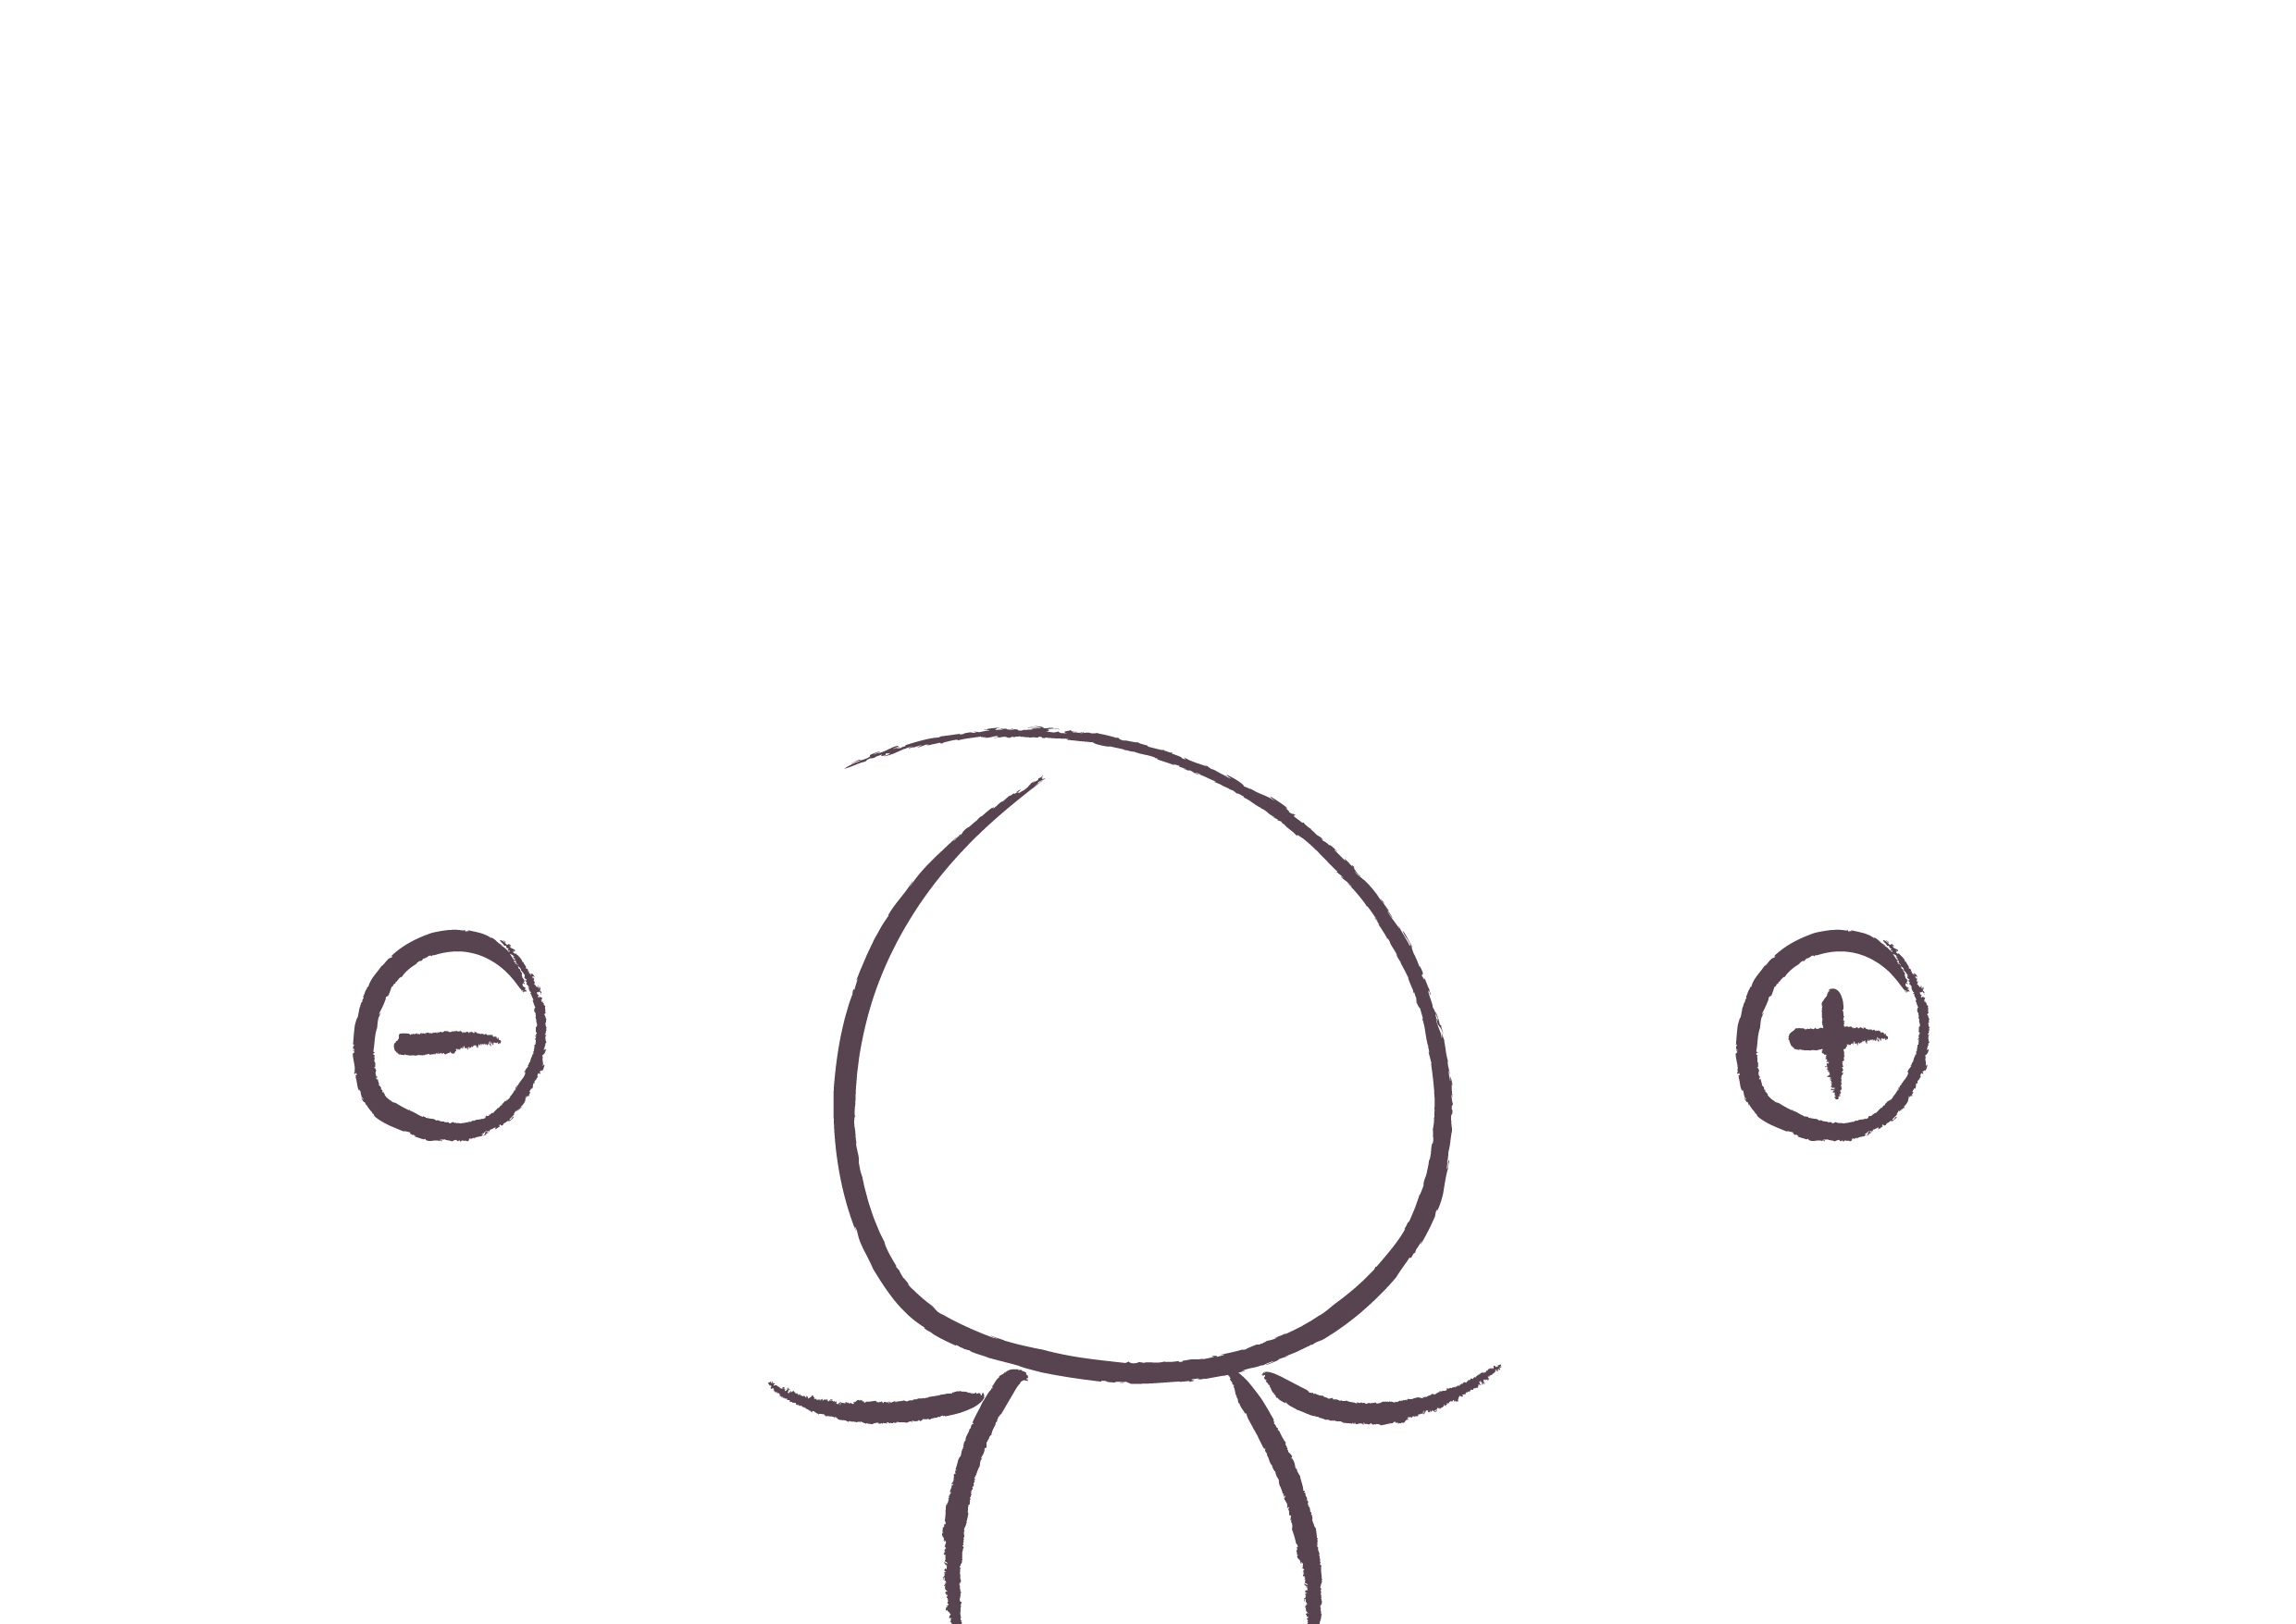
The brain is deeply social
Away
threat
Toward reward
Status
Certainty
Autonomy
Relatedness
Fairness
Notes:
The SCARF model (Rock, 2008) is a summary of important discoveries from neuroscience about the way people interact socially.
The model is built on three central ideas:
The brain treats many social threats and rewards with the same intensity as physical threats and rewards (Lieberman, & Eisenberger, 2009).
The capacity to make decisions, solve problems and collaborate with others is generally reduced by a threat response and increased under a reward response (Elliot, 2008).
The threat response is more intense and more common and often needs to be carefully minimized in social interactions (Baumeister et al, 2001). We are over sensitive to threat. It was better to assume that there was a tiger in the bush when there wasn’t than to assume there wasn’t one when there was. The optimists died!
The model is made up of Status, Certainty, Autonomy, Relatedness and Fairness. These five domains have been shown in many studies to activate the same reward circuitry that physical rewards activate, like money, and the same threat circuitry that physical threats, like pain, activate (Rock, 2009b).
The SCARF model involves five domains of human social experience: Status, Certainty, Autonomy, Relatedness and Fairness which are primary needs
• Status is about relative importance to others.
• Certainty concerns being able to predict the future.
• Autonomy provides a sense of control over events.
• Relatedness is a sense of safety with others - of friend rather than foe.
• Fairness is a perception of fair exchanges between people.
These five domains activate either the 'primary reward' or 'primary threat' circuitry (and associated networks) of the brain. For example, a perceived threat to one's status activates similar brain networks to a threat to one's life, ie activates the sympathetic nervous system. In the same way, a perceived increase in fairness activates the reward circuitry

Slide 29
Fight/flight video

Slide 30
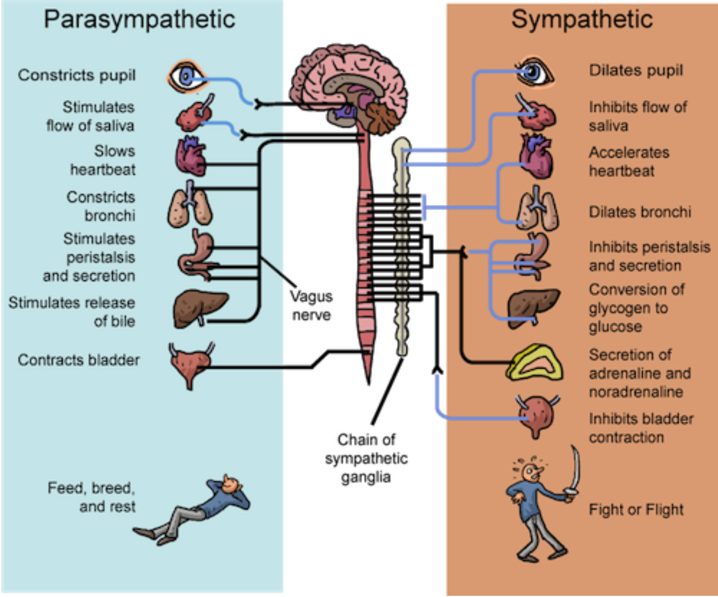

Slide 31
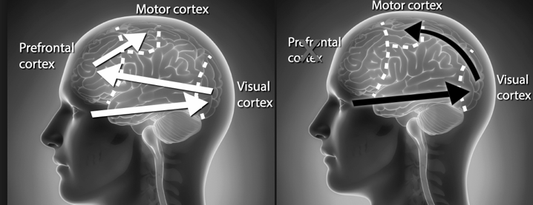
What does epinephrine do?
Normal flow of information
Flow of information after stress
Action part
of brain
Action part
of brain
Thinking brain
Thinking brain
Seeing brain
Seeing brain

Slide 32
6 part emotion cycle
Prompting event
After
effects
How I interpret it
Physical response
Action
Urge
to act
Notes:
An emotion is a reaction you have to an event. Something happens, your mind processes it, your body responds. Then you behave in response to your mind's in­terpretation and your body's response. Emotions are physiological, cognitive, and behavioral experiences. The 6 part emotion cycle that occurs is outlined below.
Prompting event. This is the stuff that happens outside you, in your environment, such as a parent cancelling a meeting, a crying child. Prompting events can also happen within you; they can be thoughts, memories, or even other emotions.
Interpretation: Your mind makes sense of what happened. The event is filtered through your evaluation, understanding, beliefs, and assumptions, and you explain it to yourself in a particular way. ‘That parent doesn’t care about their child’
Physical response. The event and your interpretation result in a physical response in your body. Your thoughts about the situation may produce stress hormones that make your heart race, your throat constrict, and your hands tremble.
Urge to act. Almost simultaneous to the physical response, you feel an urge to do something. You may or may not act on this impulse, but it's useful to notice what you feel compelled to do in those first moments. You might imagine saying accusatory things to the parent on the phone.
Action: Then there’s what you actually do, and you may or may not feel in control at this point. You may calm down and make a phone call but with a friendly greeting at the start
Aftereffects. Finally, the emotion affects other emotions, thoughts, and behavior and your body. The aftereffects can be a prompting event that sets off another emotion cycle. You might tell yourself, ‘I’m no good at this job.’
Aguilar, Elena. Onward: Cultivating Emotional Resilience in Educators. John Wiley & Sons, 2018

Slide 33
6 part emotion: positive cycle
Prompting event SE DCS peer challenge
After effects Acting on learning, asking or offering support
How I interpret it
“I’m looking forward to seeing colleagues and learning together”
Action
I’m engaged, listening, thinking, learning, having insights, feeling empathy, seeing opportunities
Physical response
PSNS restorative system activated
Urge to act
“I feel calm, relaxed, curious, interested, sociable”

Slide 34
6 part emotion: when anxiety is present
Prompting event SE DCS peer challenge
After effects I feel more anxious, disheartened and disempowered
How I interpret it
as a possible threat, ‘they’ll find out I’m an imposter’ or ‘I need to show I’m good”
Action
I’m finding it difficult to listen, I don’t agree with them
Physical response
SNS triggered
Urge to act
I feel hot, not sure I want to be here, I can’t think straight, this is annoying

Slide 35
6 part emotion: Breaking the cycle
Reframe it
Prompting event SE DCS peer challenge
After effects I feel more anxious, disheartened and disempowered
How I interpret it
as a possible threat, ‘they’ll find out I’m an imposter’ or ‘I need to show I’m good”
Action
I’m finding it difficult to listen, I don’t agree with them
Physical response
SNS triggered
Urge to act
I feel hot, not sure I want to be here, I can’t think straight, this is annoying
Calming
Resist impulse

Slide 36
The process needs to enable
the local authority presenting to get insights from the other two teams in a context that is safe and not confrontational and judgemental,
a full exploration of signatures of risk, and the chance of developing insights which may help the authority with its improvement journey.
the two other authority teams to be on the balcony during this process, asking powerful questions and sharing insights and possibilities as a result of being there, uncovering systemic rather than personal issues.

Slide 37
Listening
for insights

Slide 38
Activity
1
4
The presenter presents the self-assessment and identifies the signatures of risk they are most concerned about
15 mins
The group gets on the balcony to discuss perspectives and offer insights on the self assessment, risks, key issues and ways forward 15 mins
2
5
The group take it in turns to ask open questions to identify strengths and get a deeper perspective on the issues and consider other signatures of risk 1 hour 10 mins
The presenter reflects on what they have heard and says what they will do, including first thoughts on asks and offers
10 mins as a group and 10 mins as a response to the wider group
3
6
Each group member affirms the strengths they have observed 5 mins
At the end of the day the facilitator draws out key learning points from the group

Slide 39
Activity
1
4
The presenter presents the self-assessment and identifies the signatures of risk they are most concerned about
15 mins
The group gets on the balcony to discuss perspectives and offer insights on the self assessment, risks, key issues and ways forward 15 mins
2
5
The group take it in turns to ask open questions to identify strengths and get a deeper perspective on the issues and consider other signatures of risk 1 hour 10 mins
The presenter reflects on what they have heard and says what they will do, including first thoughts on asks and offers
10 mins as a group and 10 mins as a response to the wider group
3
6
Each group member affirms the strengths they have observed 5 mins
At the end of the day the facilitator draws out key learning points from the group

Slide 40
Signatures of risk
The broader political climate
Corporate support
Senior leadership turnover
Service reorganisation
Budget
Performance
Leading with others
Workforce
Learning culture
Practice leadership
External and internal challenge and feedback

Slide 41
Activity
1
4
The presenter presents the self-assessment and identifies the signatures of risk they are most concerned about
15 mins
The group gets on the balcony to discuss perspectives and offer insights on the self assessment, risks, key issues and ways forward 15 mins
2
5
The group take it in turns to ask open questions to identify strengths and get a deeper perspective on the issues and consider other signatures of risk 1 hour 10 mins
The presenter reflects on what they have heard and says what they will do, including first thoughts on asks and offers
10 mins as a group and 10 mins as a response to the wider group
3
6
Each group member affirms the strengths they have observed 5 mins
At the end of the day the facilitator draws out key learning points from the group

Slide 42
Examples of political climate questions
If I was in your lead member’s shoes, what would I be saying about the pace of improvement in the service. What would I say about Cabinet support for children? What would I say the DCS needed to do differently?
What would I be most concerned about?
What do you think the Leader of the Council’s perspective on children is? How do you feel about this? What has been done to address it? How do you know if this action has had any impact?
What is the current narrative about children’s services in the political realm? Is it the same or different from the corporate narrative? What is happening to address this? Will it work?
What evidence is there of the impact of children’s and parent/carer’s voice on political decisions

Slide 43
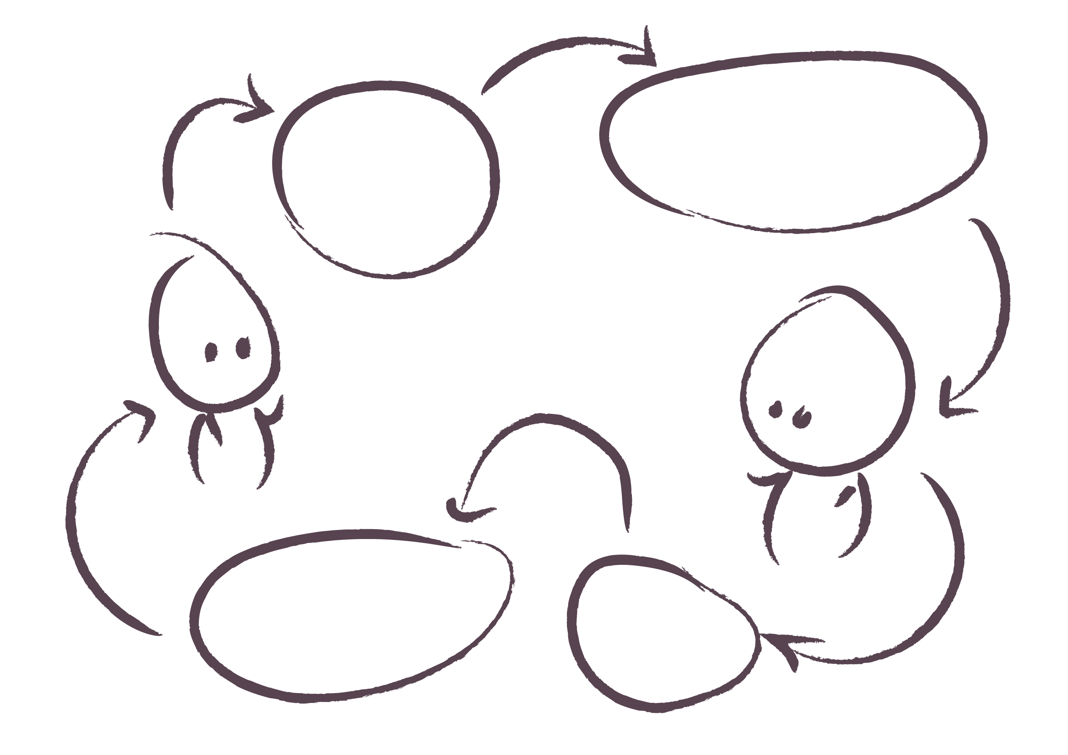
Typical listening
Bill stops listening - starts developing response
Sally starts talking, Bill listens
Sally stops listening - starts developing response
Bill starts talking, Sally listens

Slide 44
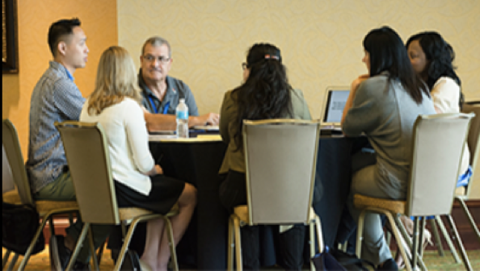
The power of listening
“The ability to be present in such a way that the mind in front of us does its own thinking” - Nancy Klein

Slide 45
Enhanced listening
We suppress extraneous thoughts
We focus attention on the person speaking
We listen from a place of kind intention
We speak slowly and do not rush our questions
We are full of curiosity about their world
We breathe deeply as we listen so we make sure our restorative system is activated

Slide 46
Listener
Active listening and powerful questions
Presents issue and responds to questions
Presenter
Balcony Listening & observing
What is happening? Is the listener effective in stimulating thinking?

Slide 47
Activity
1
4
The presenter presents the self-assessment and identifies the signatures of risk they are most concerned about
15 mins
The group gets on the balcony to discuss perspectives and offer insights on the self assessment, risks, key issues and ways forward 15 mins
2
5
The group take it in turns to ask open questions to identify strengths and get a deeper perspective on the issues and consider other signatures of risk 1 hour 10 mins
The presenter reflects on what they have heard and says what they will do, including first thoughts on asks and offers
10 mins as a group and 10 mins as a response to the wider group
3
6
Each group member affirms the strengths they have observed 5 mins
At the end of the day the facilitator draws out key learning points from the group

Slide 48
Activity
1
4
The presenter presents the self-assessment and identifies the signatures of risk they are most concerned about
15 mins
The group gets on the balcony to discuss perspectives and offer insights on the self assessment, risks, key issues and ways forward 15 mins
2
5
The group take it in turns to ask open questions to identify strengths and get a deeper perspective on the issues and consider other signatures of risk 1 hour 10 mins
The presenter reflects on what they have heard and says what they will do, including first thoughts on asks and offers
10 mins as a group and 10 mins as a response to the wider group
3
6
Each group member affirms the strengths they have observed 5 mins
At the end of the day the facilitator draws out key learning points from the group

Slide 49
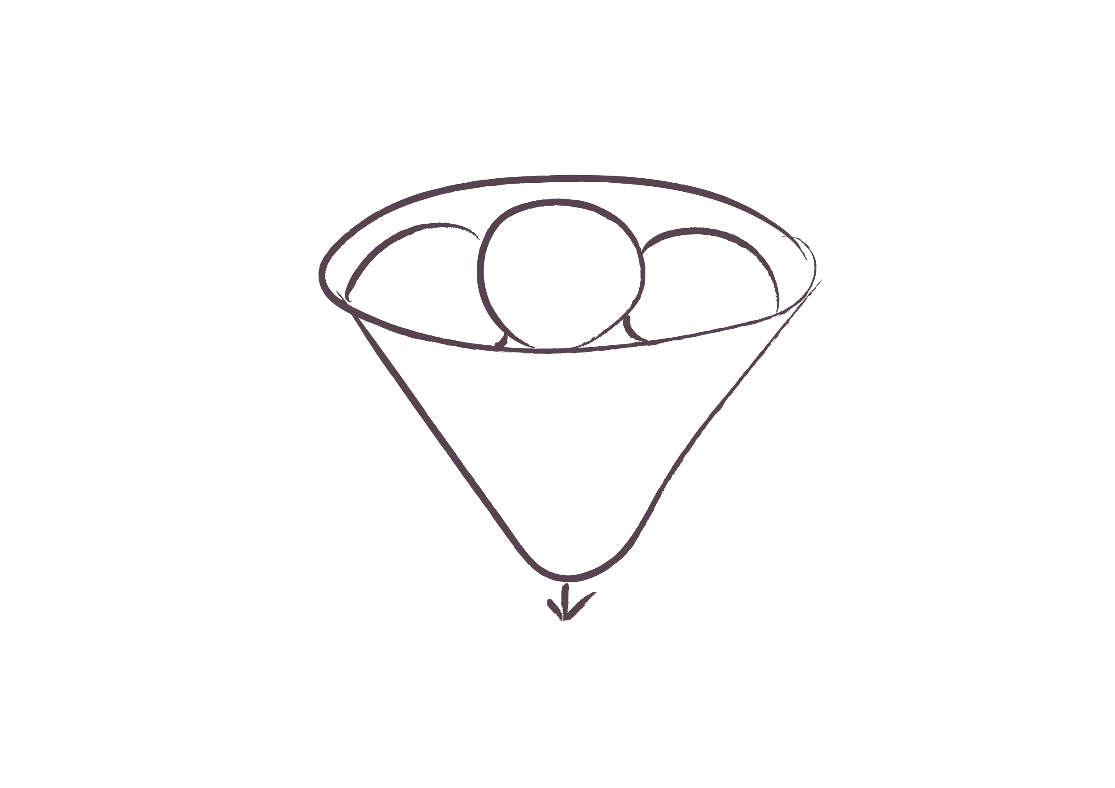
Being on the balcony
Observing
(verbal and non verbal)
Listening
Reflecting
Insights, new possibilities, options for support

Slide 50
Questions to ask from the balcony
What are the basic assumptions behind the story being told here?
How do the senior leaders define their own role in the situation and that of others?
What images or metaphors do the interviewees use? (Pay attention to the choice of words)
What do the team judge as ‘good’ and ‘bad’?
Are the descriptions based on facts or interpretations?
What assumptions are being made, do you think they are justified?
Are both positive and negative aspects being highlighted?
Are situations seen as static or dynamic?

Slide 51
Activity
1
4
The presenter presents the self-assessment and identifies the signatures of risk they are most concerned about
15 mins
The group gets on the balcony to discuss perspectives and offer insights on the self assessment, risks, key issues and ways forward 15 mins
2
5
The group take it in turns to ask open questions to identify strengths and get a deeper perspective on the issues and consider other signatures of risk 1 hour 10 mins
The presenter reflects on what they have heard and says what they will do, including first thoughts on asks and offers
10 mins as a group and 10 mins as a response to the wider group
3
6
Each group member affirms the strengths they have observed 5 mins
At the end of the day the facilitator draws out key learning points from the group

Slide 52
Activity
1
4
The presenter presents the self-assessment and identifies the signatures of risk they are most concerned about
15 mins
The group gets on the balcony to discuss perspectives and offer insights on the self assessment, risks, key issues and ways forward 15 mins
2
5
The group take it in turns to ask open questions to identify strengths and get a deeper perspective on the issues and consider other signatures of risk 1 hour 10 mins
The presenter reflects on what they have heard and says what they will do, including first thoughts on asks and offers
10 mins as a group and 10 mins as a response to the wider group
3
6
Each group member affirms the strengths they have observed 5 mins
At the end of the day the facilitator draws out key learning points from the group

Slide 53
What does each authority need to do before, during and after the peer challenge day to get the most learning out of this process?

Slide 54
Feedback and plenary

Slide 55
SE DCS peer challenge
annawright@me.com

